Slide 1
Recap Lecture 12
Examples of writing REs to the corresponding TGs, RE corresponding to TG accepting EVEN-EVEN language, Kleene’s theorem part III (method 1:union of FAs), examples of FAs corresponding to simple REs, example of Kleene’s theorem part III (method 1) continued

Slide 2
Note
It may be noted that in the previous example FA₁ contains two states while FA₂ contains three states. Hence the total number of possible combinations of states of FA₁ and FA₂, in sequence, will be six. For each combination the transitions for both a and b can be determined, but using the method in the example, number of states of FA₃ was reduced to five.

Slide 3
Task
Build an FA equivalent to the previous FA
Z₂
a
a
b
a
b
Z₁-
a
b
Z₄ +
Z₅ +
b
a
Z₃+
b

Slide 4
Example
Let r₁=(a+b)*a and the corresponding FA₁ be
also r₂ = (a+b)((a+b)(a+b))* or ((a+b)(a+b))*(a+b) and FA₂ be
b
a
a
X₁–
X₂+
b
a,b
y₁-
y₂+
a,b

Slide 5
Example continued …
b
a
a
a,b
X₁–
X₂+
y₁-
y₂+
a,b
b
Old States | New States after reading
 | a | b
z₁-(x₁,y₁) | (x₂,y₂) z₂ | (x₁,y₂)  z₃

Slide 6
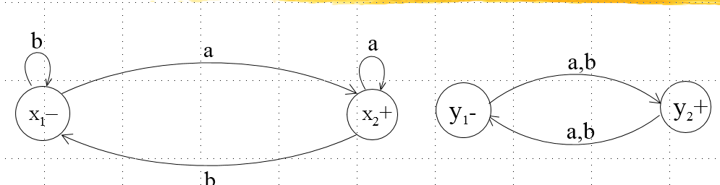
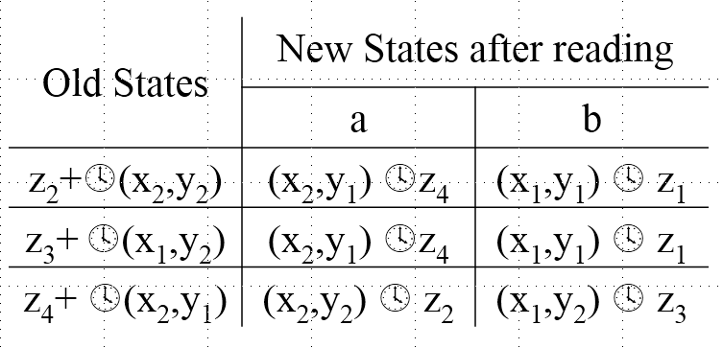
Example continued …

Slide 7
Example continued …
Old States | New States after reading
 | a | b
z₂+(x₂,y₂) | (x₂,y₁) z₄ | (x₁,y₁)  z₁
z₃+ (x₁,y₂) | (x₂,y₁) z₄ | (x₁,y₁)  z₁
z₄+ (x₂,y₁) | (x₂,y₂)  z₂ | (x₁,y₂)  z₃

Slide 8
Example continued …
a
z₁-
z₂+
b
b
b
a
a
a
z₃+
z₄+
b

Slide 9
Class task
Let r₁=((a+b)(a+b))* and the corresponding FA₁ be
also r₂ = (a+b)((a+b)(a+b))* or ((a+b)(a+b))*(a+b) and FA₂ be
a,b
x₁±
x₂
a,b
a,b
y₁-
y₂+
a,b

Slide 10
Example continued …
a,b
x₁±
x₂
a,b
a,b
y₁-
y₂+
a,b
Old States | New States after reading
 | a | b
z₁±(x₁,y₁) | (x₂,y₂) z₂ | (x₂,y₂)  z₂

Slide 11
Example continued …
Old States | New States after reading
 | a | b
z₂+(x₂,y₂) | (x₁,y₁) z₁ | (x₁,y₁)  z₁

Slide 12
Example continued …
a,b
z₁ ±
z₂+
a,b

Slide 13
Home Task
Build an FA corresponding to the union of these two FAs i.e. FA₁ U FA₂ where
FA₁
FA₂
a,b
x₂
b
x₃ +
x₁ -
a,b
a
x₄
a,b
b
a
b
y₁ -
y₂+
a

Slide 14
Kleene’s Theorem Part III Continued …
Method2 (Concatenation of two FAs):
Using the FAs corresponding to r₁ and r₂, an FA can be built, corresponding to r₁r₂. This method can be developed considering the following examples

Slide 15
Example
Let r₁=(a+b)*b defines L₁ and FA₁ be
and r₂ = (a+b )*aa (a+b )* defines L₂ and FA₂ be
a
b
b
X₁–
X₂+
a
b
a,b
a
y₁-
y₂
a
y₃+
b

Slide 16
Concatenation of two FAs Continued …
Let FA₃ be an FA corresponding to r₁r₂, then the initial state of FA₃ must correspond to the initial state of FA₁ and the final state of FA₃ must correspond to the final state of FA₂.Since the language corresponding to r₁r₂ is the concatenation of corresponding languages L₁ and L₂, consists of the strings obtained, concatenating the strings of L₁ to those of L₂ , therefore the moment a final state of first FA is entered, the possibility of the initial state of second FA will be included as well.

Slide 17
Concatenation of two FAs Continued …
Since, in general, FA₃ will be different from both FA₁ and FA₂, so the labels of the states of FA₃ may be supposed to be z₁,z₂, z₃, …, where z₁ stands for the initial state. Since z₁ corresponds to the states x₁, so there will be two transitions separately for each letter read at z₁. It will give two possibilities of states which correspond to either z₁ or different from z₁. This process may be expressed in the following transition table for all possible states of FA₃

Slide 18
Example continued …
a
b
b
X₁–
X₂+
b
a
a,b
a
y₁-
y₂
a
y₃+
b
Old States | New States after reading
 | a | b
z₁-x₁ | x₁z₁ | (x₂,y₁) z₂

Slide 19
Example continued …
Old States | New States after reading
 | a | b
z₂(x₂,y₁) | (x₁,y₂)z₃ | (x₂,y₁) z₂
z₃(x₁,y₂) | (x₁,y₃)z₄ | (x₂,y₁) z₂
z₄+(x₁,y₃) | (x₁,y₃) z₄ | (x₂,y₁,y₃) z₅
z₅+(x₂,y₁,y₃) | (x₁,y₂ ,y₃) z₆ | (x₂,y₁,y₃) z₅
z₆+(x₁,y₂,y₃) | (x₁,y₃) z₄ | (x₂ ,y₁,y₃) z₅

Slide 20
Example continued …
b
a
z₂
z₃
b
a
b
a
z₁-
z₄+
a
a
b
b
b
z₆+
z₅+
b
a

Slide 21
Summing Up
Examples of Kleene’s theorem part III (method 1) continued ,Kleene’s theorem part III (method 2: Concatenation of FAs),
Example of Kleene’s theorem part III (method 2 : Concatenation of FAs)

